Slide 1







Applied Data Science Capstone
João Pedro Moura Braga
https://github.com/jpmouradev
1/29/2023

Slide 2



OUTLINE
Executive Summary
Introduction
Methodology
Results
Visualization – Charts
Dashboard
Conclusion

Slide 3

EXECUTIVE SUMMARY
Data gathered from the SpaceX Wikipedia page and open SpaceX API. Labels column 'class' was created to categorize successful landings. Used SQL, visualization, folium maps, and dashboards to explore the data. Compiled pertinent columns for use as features. Used a single hot encoding to convert all categorical variables to binary. GridSearchCV was used to determine the ideal parameters for machine learning models using standardized data. Display the accuracy rating for each model.
Logistic Regression, Support Vector Machine, Decision Tree Classifier, and K Nearest Neighbors are the four machine learning models that were created. All gave identical results, with an average accuracy percentage of 83.33%. Successful landings were anticipated by all models. For improved model determination and accuracy, more data is required.

Slide 4

INTRODUCTION
On its website, SpaceX promotes flights of the 62 million dollar Falcon 9 rocket. Other companies charge upwards of 165 million dollars per service; SpaceX can save money by recycling the first stage.
Predicting whether the first stage of the SpaceX Falcon 9 rocket will successfully land is the problem at hand.

Slide 5

METHODOLOGY
Data Collection
Data Wrangling
Data Visualization
Dashboard
Model Methods

Slide 6
Data Collection
A combination of API queries from Space X's public API and web scraping data from a table in Space X's Wikipedia entry were used in the data collection procedure. The flowchart for data collection from an API is shown on the following slide, and the flowchart for data collection via web scraping is shown on the slide after that.
Space X API Data Columns:
FlightNumber, Date, BoosterVersion, PayloadMass, Orbit, LaunchSite, Outcome, Flights, GridFins, Reused, Legs, LandingPad, Block, ReusedCount, Serial, Longitude, Latitude
Wikipedia Webscrape Data Columns:
Flight No., Launch site, Payload, PayloadMass, Orbit, Customer, Launch outcome, Version Booster, Booster landing, Date, Time

Slide 7
Data Collection – SpaceX API
Steps:
Request
JSON file and Lists
Create DataFrame data from JASON
Put relevant data on a dictionary
Put dictionary on a DataFrame
Filter Data to only Falcon 9
Calculate mean to get missing PayloadMass values

Slide 8
Data Collection – Web Scrapping
Steps:
Request
Use BeautifulSoup parser
Find launch info on table
Create dictionary
Extract data to dictionary by iterating table cells
Put dictionary on a DataFrame

Slide 9
Data Wrangling
Steps:
Check full values
Calculate the number of launches on each site
Calculate the number and occurrence of each orbit
Calculate the number and occurrence of mission outcome per orbit type
Create a landing outcome label from Outcome Column
Handle null values

Slide 10
EDA with Data Visualization
The variables Flight Number, Payload Mass, Launch Site, Orbit, Class, and Year were subjected to exploratory data analysis.
Plots used:
Flight Number vs. Payload Mass, Flight Number vs. Launch Site, Payload Mass vs. Launch Site, Orbit vs. Success Rate, Flight Number vs. Orbit, Payload vs Orbit, and Success Yearly Trend
To determine whether a relationship between two variables exists so that it may be used in training the machine learning model, scatter plots, line charts, and bar plots were used.

Slide 11
EDA with SQL
Loaded data set into IBM DB2 Cloud Database
Query using SQL with Python
To understand the dataset better, queries were run.
Enquired about the identities of the launch sites, the results of the missions, the various payload sizes of the customers and booster iterations, and the results of the landings.

Slide 12
Build an interactive map with Folium
Launch sites, successful and unsuccessful landings, and examples of important destinations that are close by are marked on folium maps, including railways, highways, coasts, and cities.
This enables us to comprehend possible reasons for the placement of launch sites. visualizes successful landings in relation to their location as well.

Slide 13
Build a Dashboard with Plotly Dash
Dashboard has a scatter plot and a pie chart.
Pie charts can be chosen to display the distribution of successful landings among all launch locations as well as the success rates of individual launch sites.
The payload mass on a slider between 0 and 10,000 kg, and either all sites or a specific site, are the two inputs for the scatter plot.
The success rate of the launch site is displayed via a pie chart.
We can examine how success varies among launch sites, payload tonnage, and booster version category using the scatter plot.

Slide 14
Predictive analysis (Classification)
Steps:
Split label column Class from dataset
Fit and transform features using standard scaler
Train_test_split data
Score models on split test set
Use GridSearchCV on LogReg, SVM, Decision Tree and KNN models
GridSearchCV to find parameters
Confusion Matrix for all models
Barplot to compare scores of models

Slide 15
LIST OF RESULTS
EDA with Visualization
EDA with SQL
Interactive map with Folium
Plotly Dash dashboard
Predictive analysis (Classification)

Slide 16
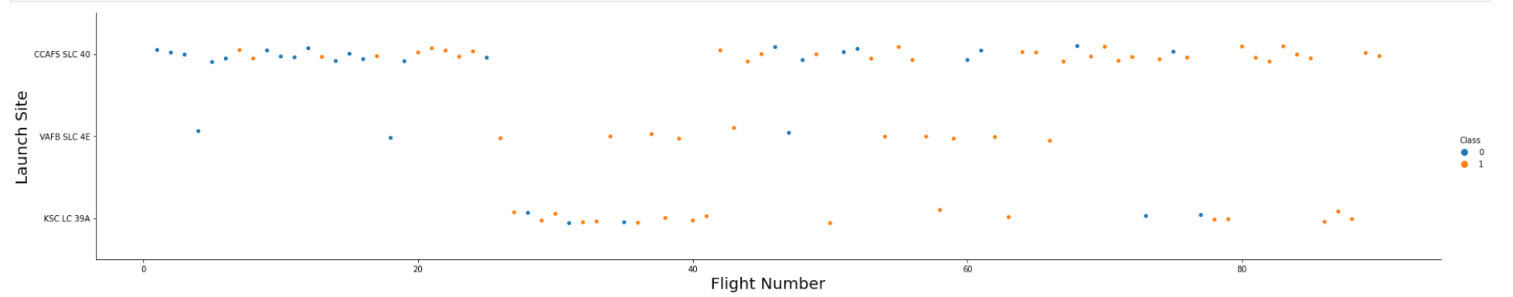
RESULTS - EDA with Visualization
The graph depicts a rising success rate over time (indicated in Flight Number).
Most likely, there was a huge development around flight 20 that greatly improved the success rate.
Given its volume, CCAFS looks to be the primary launch point.

Slide 17
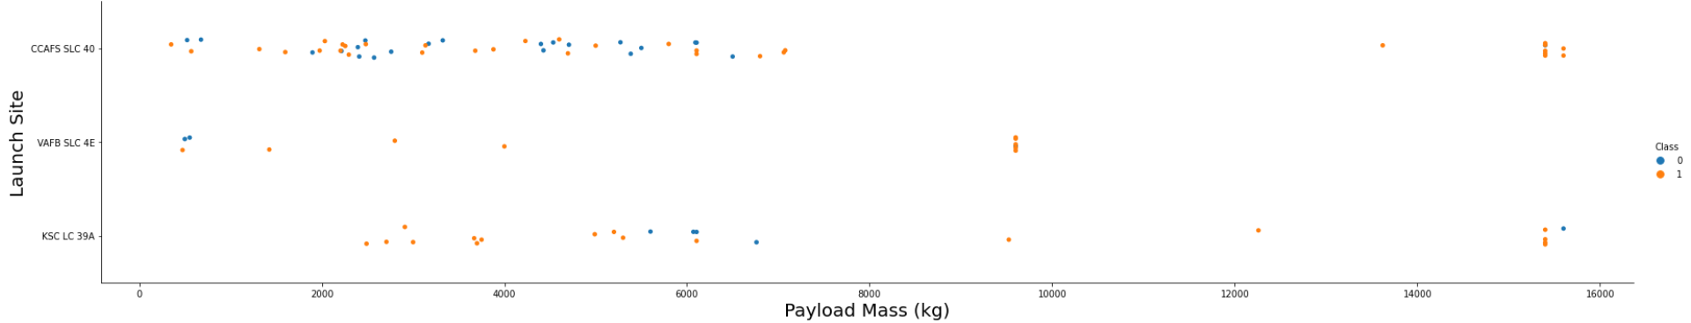
RESULTS - EDA with Visualization
Payload mass looks to range from 0 to 6000 kg for the most part.
Additionally, different launch sites appear to employ various payload masses.

Slide 18
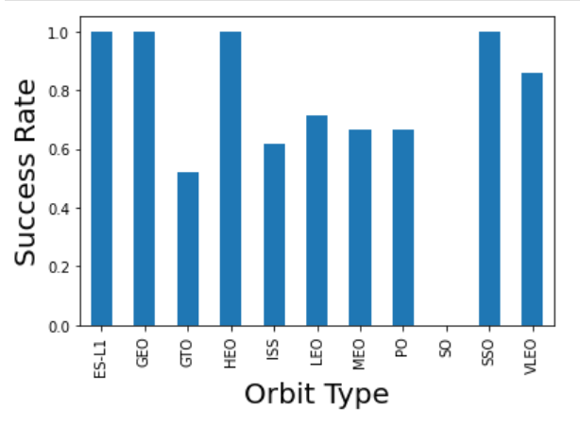
RESULTS - EDA with Visualization
ES-L1 (1), GEO (1), HEO (1) have 100% success rate (sample sizes in parenthesis)
SSO (5) has 100% success rate
VLEO (14) has decent success rate and attempts
SO (1) has 0% success rate
GTO (27) has the around 50% success rate but largest sample

Slide 19
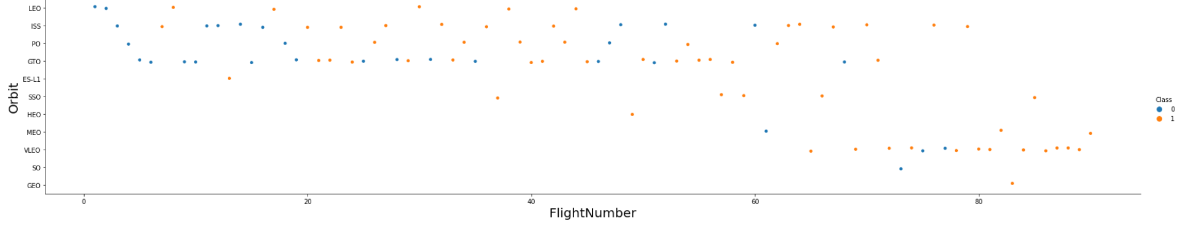
RESULTS - EDA with Visualization
Flight Number was preferred over Launch Orbit.
This preference appears to be correlated with Launch Outcome.
SpaceX began with LEO orbits, which had some success, before switching back to VLEO in more recent flights.
It seems that SpaceX performs better in lower or Sun-synchronous orbits.

Slide 20
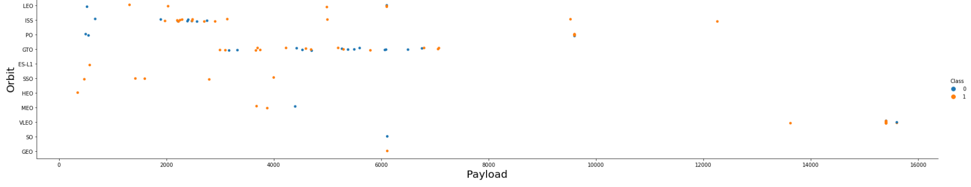
RESULTS - EDA with Visualization
Payload mass and orbit appear to be correlated, with LEO and SSO having relatively modest payload masses.
Only payload mass values at the upper end of the range are available for the other most successful orbit VLEO.

Slide 21
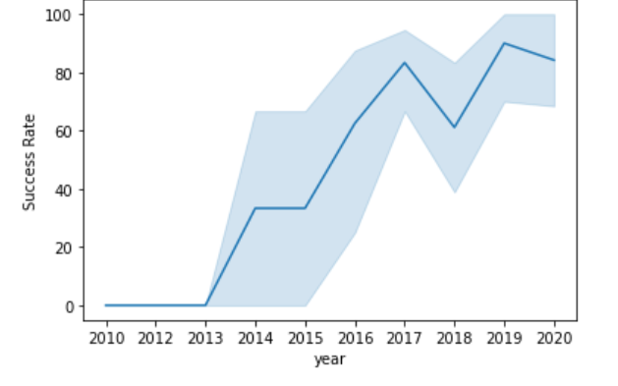
RESULTS - EDA with Visualization
Since 2013, success has typically increased with a little decline in 2018.
Success has been about 80% in recent years.

Slide 22
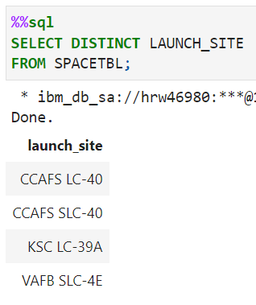
RESULTS - EDA with SQL
Search the database for unique launch site names.
Both CCAFS SLC-40 and CCAFSSLC-40 most likely refer to the same launch location with incorrect data entry.
The previous name was CCAFS LC-40. Probably only 3 distinct launch site values: VAFB SLC-4E, KSC LC-39A, CCAFS SLC-40, and KSC

Slide 23
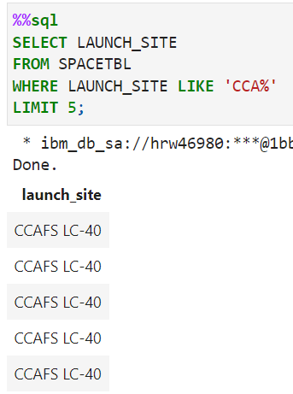
RESULTS - EDA with SQL
First five entries in database with Launch Site name beginning with CCA.

Slide 24
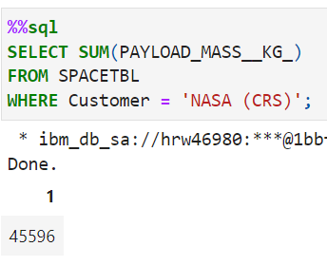
RESULTS - EDA with SQL
When NASA was the customer, this query adds up the total payload mass in kilograms.
CRS, or Commercial Resupply Services, is a designation for the International Space Station, where these payloads were delivered (ISS).

Slide 25
RESULTS - EDA with SQL
When NASA was the customer, this query adds up the total payload mass in kilograms.
CRS, or Commercial Resupply Services, is a designation for the International Space Station, where these payloads were delivered (ISS).

Slide 26
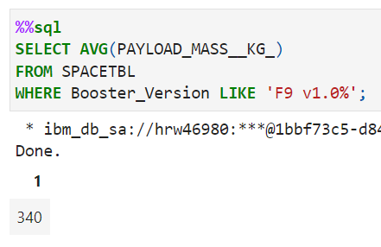
RESULTS - EDA with SQL
The average payload mass for launches that utilized booster version F9 v1.1 is determined by this query.
F9 1.1's average payload mass is on the lower end of our payload mass range.

Slide 27
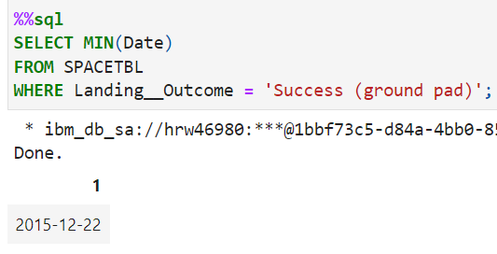
RESULTS - EDA with SQL
The first successful ground pad landing date is returned by this query.
It took till the end of 2015 for the initial ground pad landing.
In general, successful landings start to occur in 2014.

Slide 28
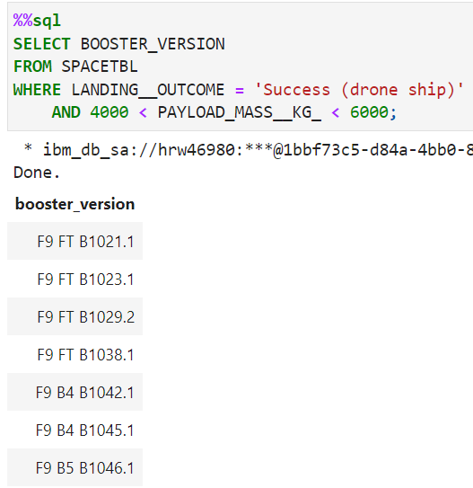
RESULTS - EDA with SQL
The four booster types with successful drone ship landings and a payload mass between 4,000 and 6,000 are returned by this search.

Slide 29
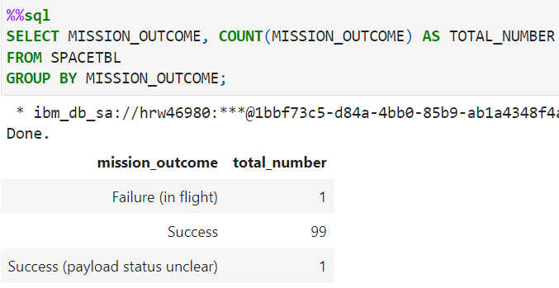
RESULTS - EDA with SQL
This search yields a count of each mission result.
It seems like SpaceX completes its missions almost 99% of the time.
This indicates that the majority of landing mishaps are deliberate.
Interestingly, one launch's payload status is unknown, and regrettably, one launch failed in flight.

Slide 30
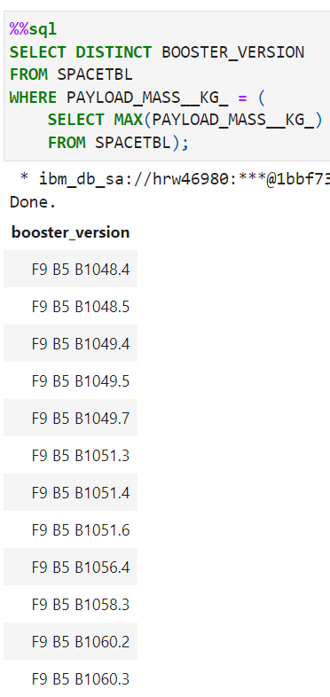
RESULTS - EDA with SQL
The results of this search are the booster iterations that could lift a payload of up to 15600 kg.
These booster variants are all of the F9 B5 B10xx.x variety and are remarkably similar.
This suggests that the payload mass and the booster design are related.

Slide 31
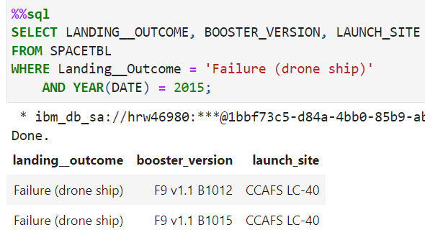
RESULTS - EDA with SQL
The results of this search are the 2015 launches where stage 1 failed to land on a drone ship, along with the Month, Landing Outcome, Booster Version, Payload Mass (kg), and Launch Site.
There were two instances like this.

Slide 32
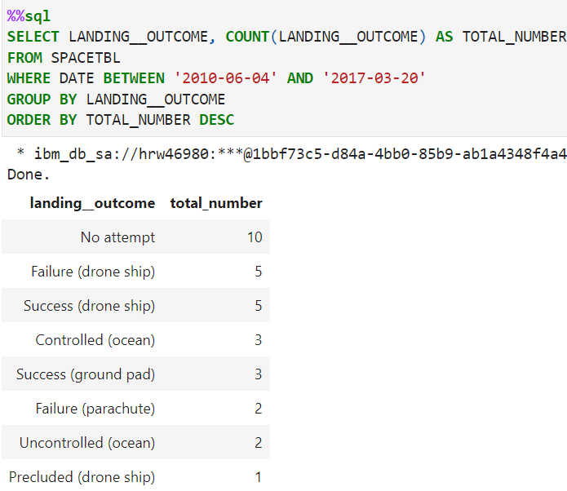
RESULTS - EDA with SQL
A list of successful landings between 2010-06-04 and 2017, inclusive, are returned by this query.
Drone ship landings and ground pad landings are the two different forms of successful landing results.
In total, 8 landings were accomplished during this time frame.

Slide 33
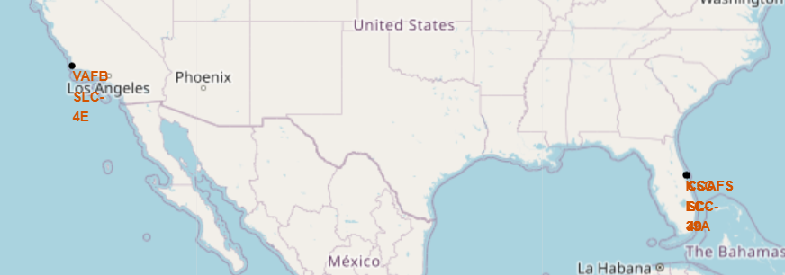
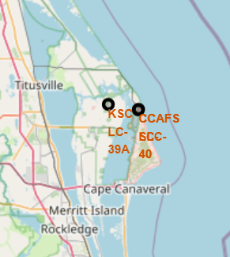
Interactive Map with Folium
The left map displays a relative US map with all launch sites. Due to their proximity, the two Florida launch sites are shown on the right map. Every launch place is close to the water.

Slide 34
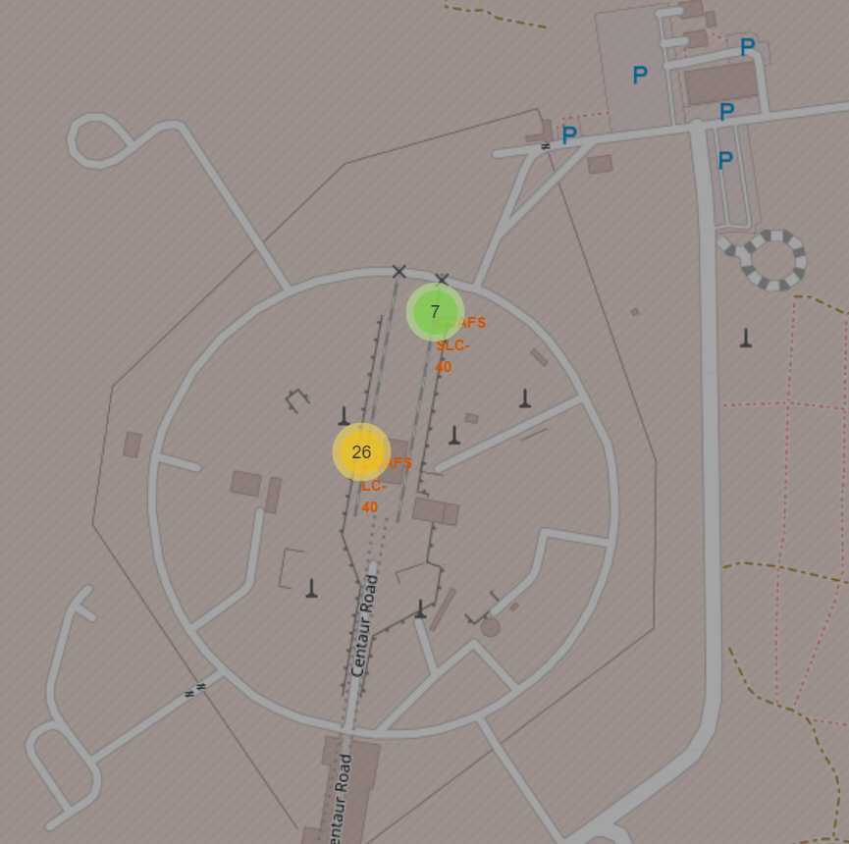
Interactive Map with Folium
Clicking on clusters on the Folium map will show each successful and unsuccessful landing.

Slide 35
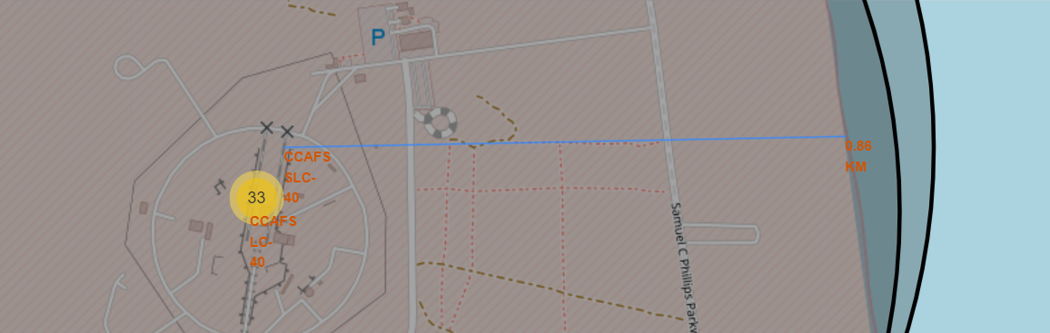
Interactive Map with Folium
Example of distance calculation.

Slide 36
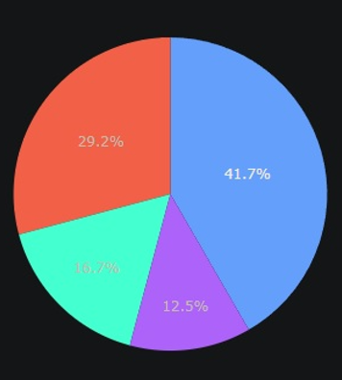
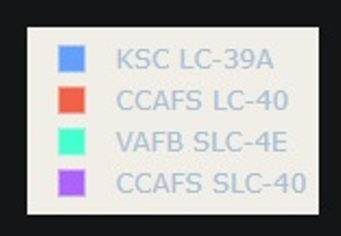
Build a Dashboard with Plotly Dash
This graph shows how successful landings have been distributed throughout all launch sites. The number of successful landings for CCAFS and KSC is equal, however the majority of them took place before to the name change because CCAFS LC-40 was the previous name for CCAFS SLC-40. The least number of successful landings occur at VAFB. This might be because the sample size was lower and launching was more challenging on the west coast.

Slide 37
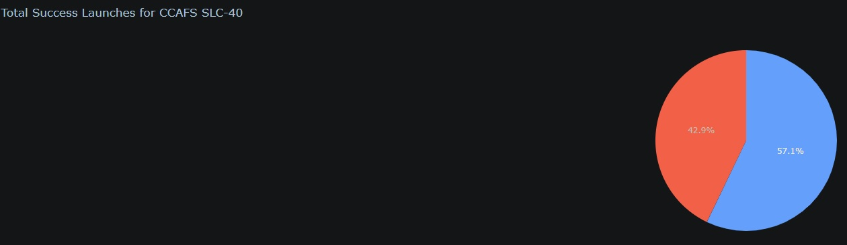
Build a Dashboard with Plotly Dash
CCAFS SLC-40 has the success rate of 57.1% and failed landings with 42.9%.

Slide 38
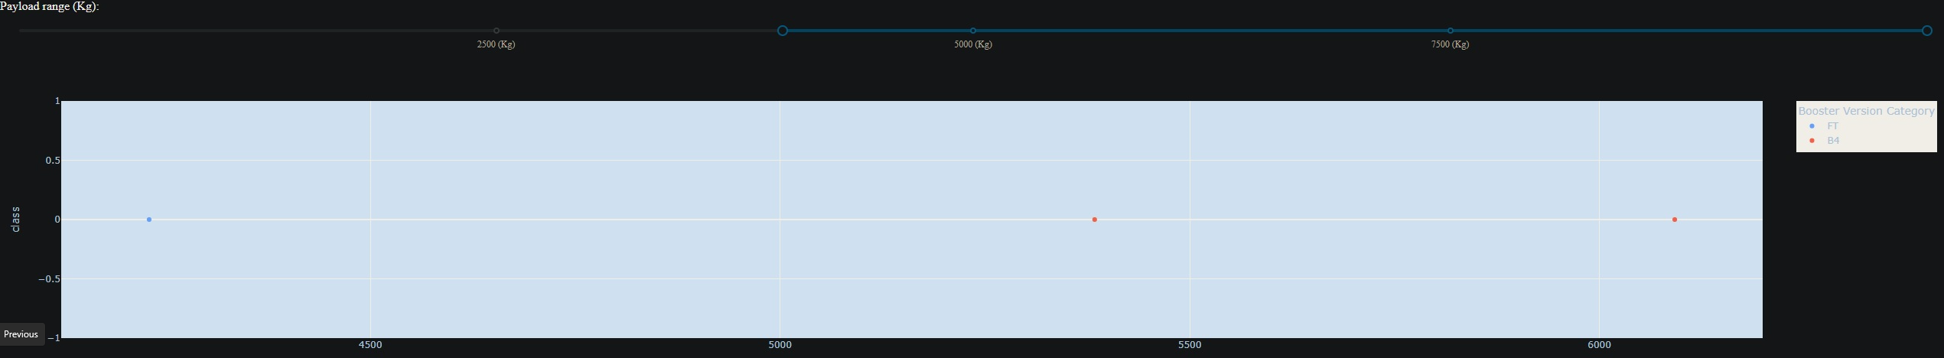
Build a Dashboard with Plotly Dash
Using the Payload range selector on the Plotly dashboard. However, instead of the maximum Payload of 15600, this is set from 0 to 10,000. Class displays 1 for a successful landing and 0 for an unsuccessful one. The booster version category in color and the number of launches in point size are also taken into account by the scatter plot.

Slide 39
Predictive Analysis (Classification)
On the test set, all models' accuracy was 83.33%, or essentially the same.
It should be emphasized that the sample size of 18 is a modest test size.
When a decision tree classifier model is used repeatedly, this can result in a significant variance in accuracy outcomes.
To choose the optimal model, we probably require more information.

Slide 40
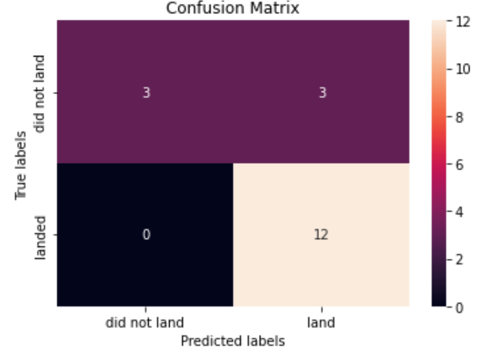
Build a Dashboard with Plotly Dash
The diagonal of correct guesses runs from top left to bottom right.
The confusion matrix is the same for all models because their performance on the test set was identical.
When the actual label was successful landing, the models projected 12 successful landings.
When the actual label was failure landing, the models projected three unsuccessful landings.
When the actual label was failed landings, the models projected three successful landings (false positives). Our forecasts overestimate the success of landings.

Slide 41

CONCLUSION
Our job is to create a machine learning model that can forecast when Stage 1 will successfully land in order to save Space Y, which wants to compete against SpaceX, about $100 million USD.
Used information from the SpaceX Wikipedia page and a public SpaceX API.
Built a dashboard for visualization, created data labels, and entered data into a DB2 SQL database.
Our machine learning model had an 83% accuracy rate.
In order to decide whether or not to proceed with a launch, Allon Mask of SpaceY can use this model to forecast, with a fair amount of accuracy, if a launch will have a successful Stage 1 landing.
To improve accuracy and choose the optimum machine learning model, more data should ideally be gathered.

